Slide 1

Automation Testing
By- Manas

Slide 2
REUSABLE METHODS
We are using reusable methods to perform the validations in selenium. Sometimes we need to write the same logic for multiple times. In that case instead of writing the same lines of the code again and again, we are making that logic as a method. So that we can use that method whenever we required that logic.
Note:
In Real Time most of the validations we are performing with the help of Reusable methods in WebDriver.

Slide 3
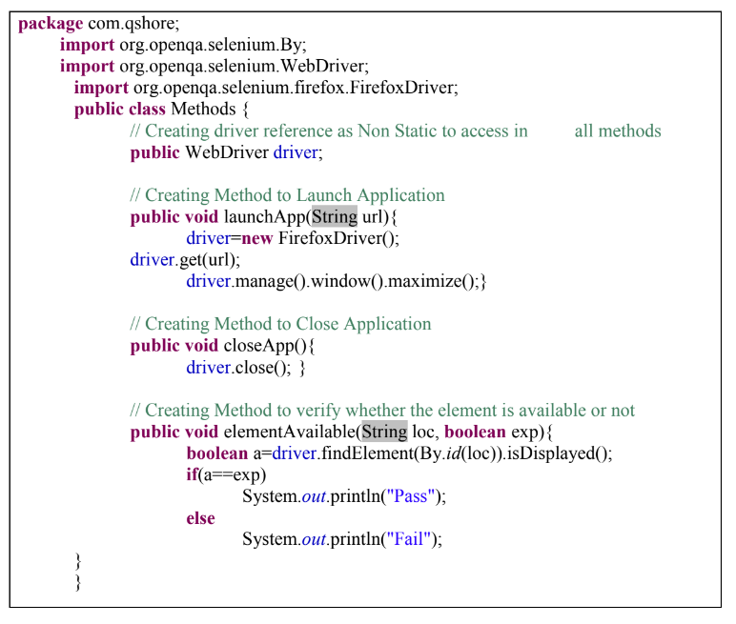
Example: Prepare the methods for below operations and validations
1. Launch Application
2. Close Application
3. Whether the element is available or not

Slide 4
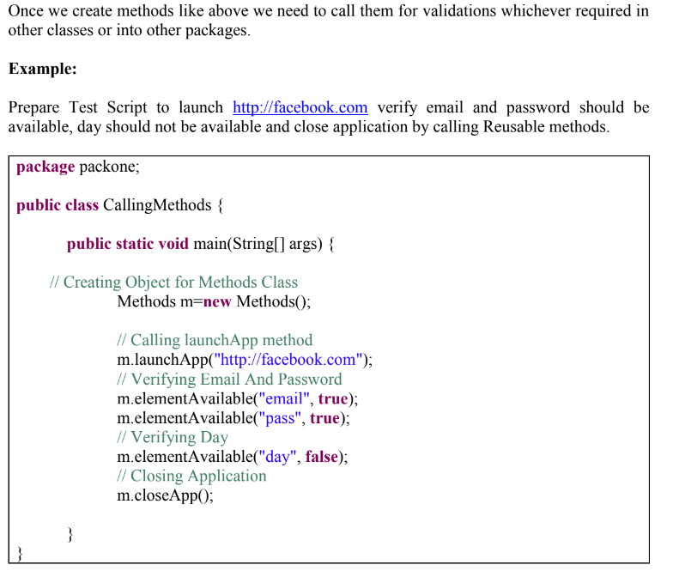
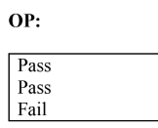

Slide 5
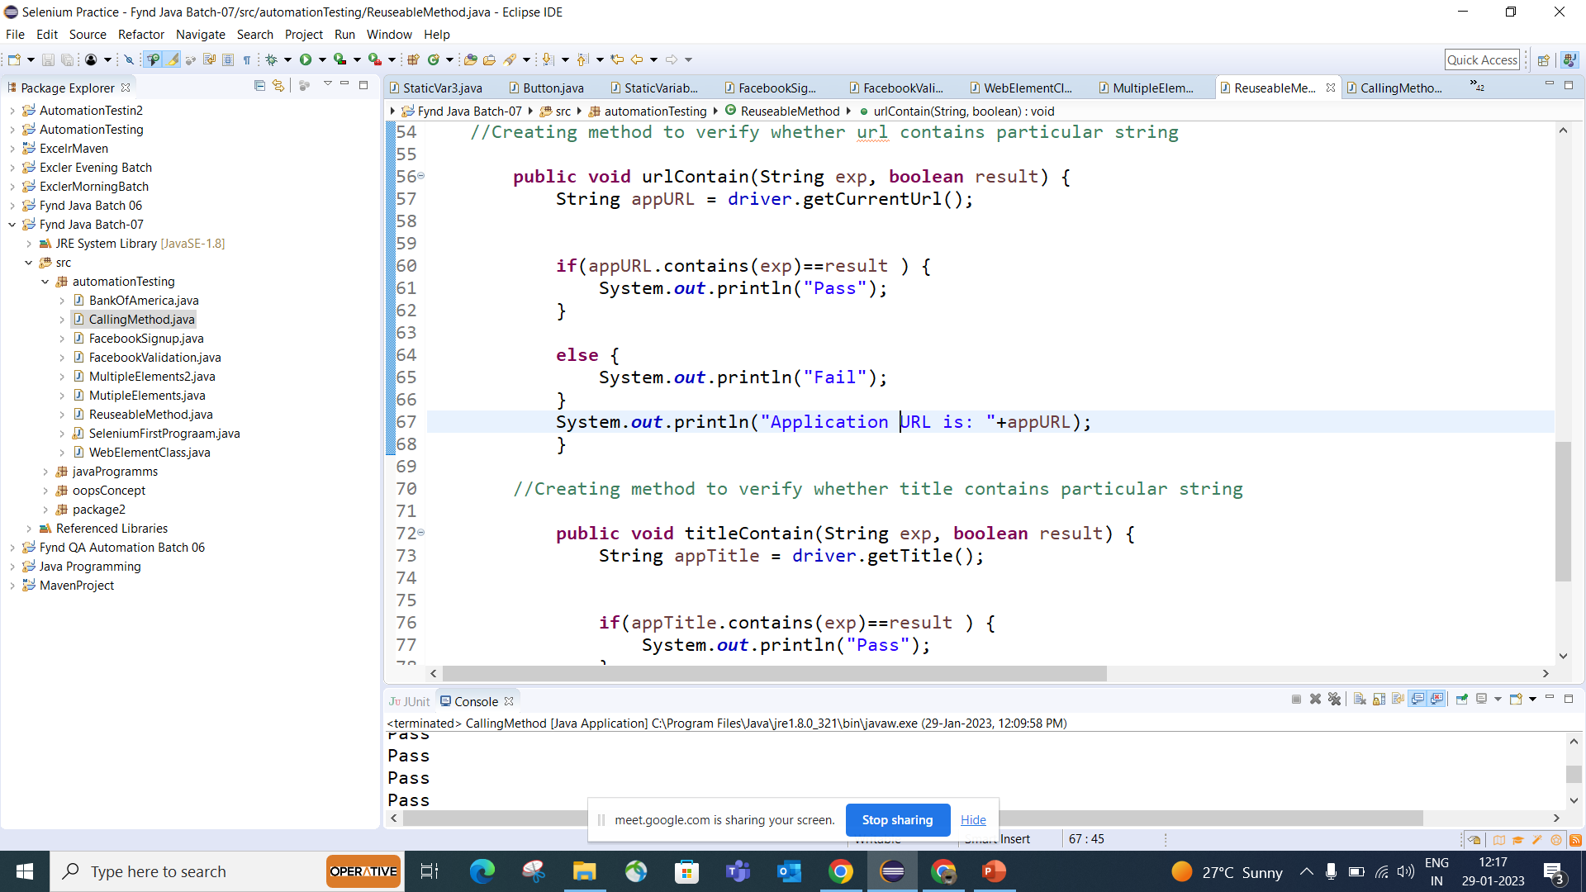

Slide 6
Practice Problem: Prepare Reusable Methods for the below validations
1. Element Should be Enabled
2. Number of Links should be 20
3. Title of the application length should be 30
4. URL should contains “.com”
5. Title should starts with “K”

Slide 7
FAQ’s
1. What is Method
2. What is the purpose of methods in selenium
3. Are you using methods in your project?
4. Can you give me some methods which you are using in your project
5. What is the difference between method and method with arguments?

